Slide 1

WINE-ALYTICS
WHEN DATA MEETS WINE
Liz Calvo
Michelle Halvorsen
Syed Hossain
Melanie Nyuydzefe
Greg Sobchuk
Notes:
Liz

Slide 2
BEFORE WE DIVE IN…
LET’S REVIEW UPDATES TO OUR
PRICE CLASSIFICATION TOOL
Notes:
In order to increase the performance of our classification algorithm, we created a Gradient Boosting Classifier, rather than a Random Forest Classifier. In gradient boosting, each predictor in the ensemble corrects its predecessor's error. More specifically, each predictor is trained using the residual errors of its predecessor as labels. However, as with the Random Forest Classifier, our new model also suffered from underfitting (increased bias). To mitigate this effect, we made the Gradient Boosting Classifier _Stochastic_ and finetuned the hyperparameters using random grid search, with the goal of maximizing the Area Under the Curve. This drastically improved the performance of our model, and gave us new insights, such as the importance of the different variables

Slide 3
UNDERVALUED
OVERVALUED
DATA
Stochastic GradientBoostingEstimator with tuned hyperparameters
Addresses underfitting (increased bias)
Maximizes AUC-score
YOUR WINE
Notes:
Michelle

Slide 4
AGENDA
01.
03.
02.
04.
About Wine-alytics
Our Products & Project Summary
What are our goals
What we offer
Our Clients & The Problem
Deliverables & Partnership Benefits
Who we work with
How we can work together
Notes:
Liz

Slide 5
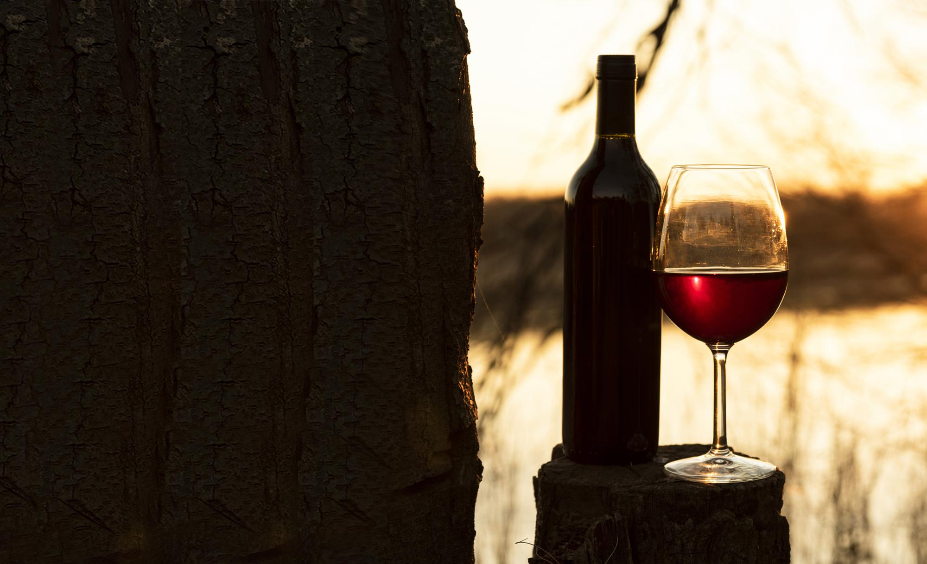
01.
ABOUT WINE-ALYTICS
OUR GOALS
Notes:
Liz

Slide 6

ABOUT US
At Wine-alytics, we are passionate about wine… and data! We analyze data on the physical chemistry of wines from all over the world and provide wineries with recommendations on what chemical components lead to great wines
Notes:
Liz

Slide 7
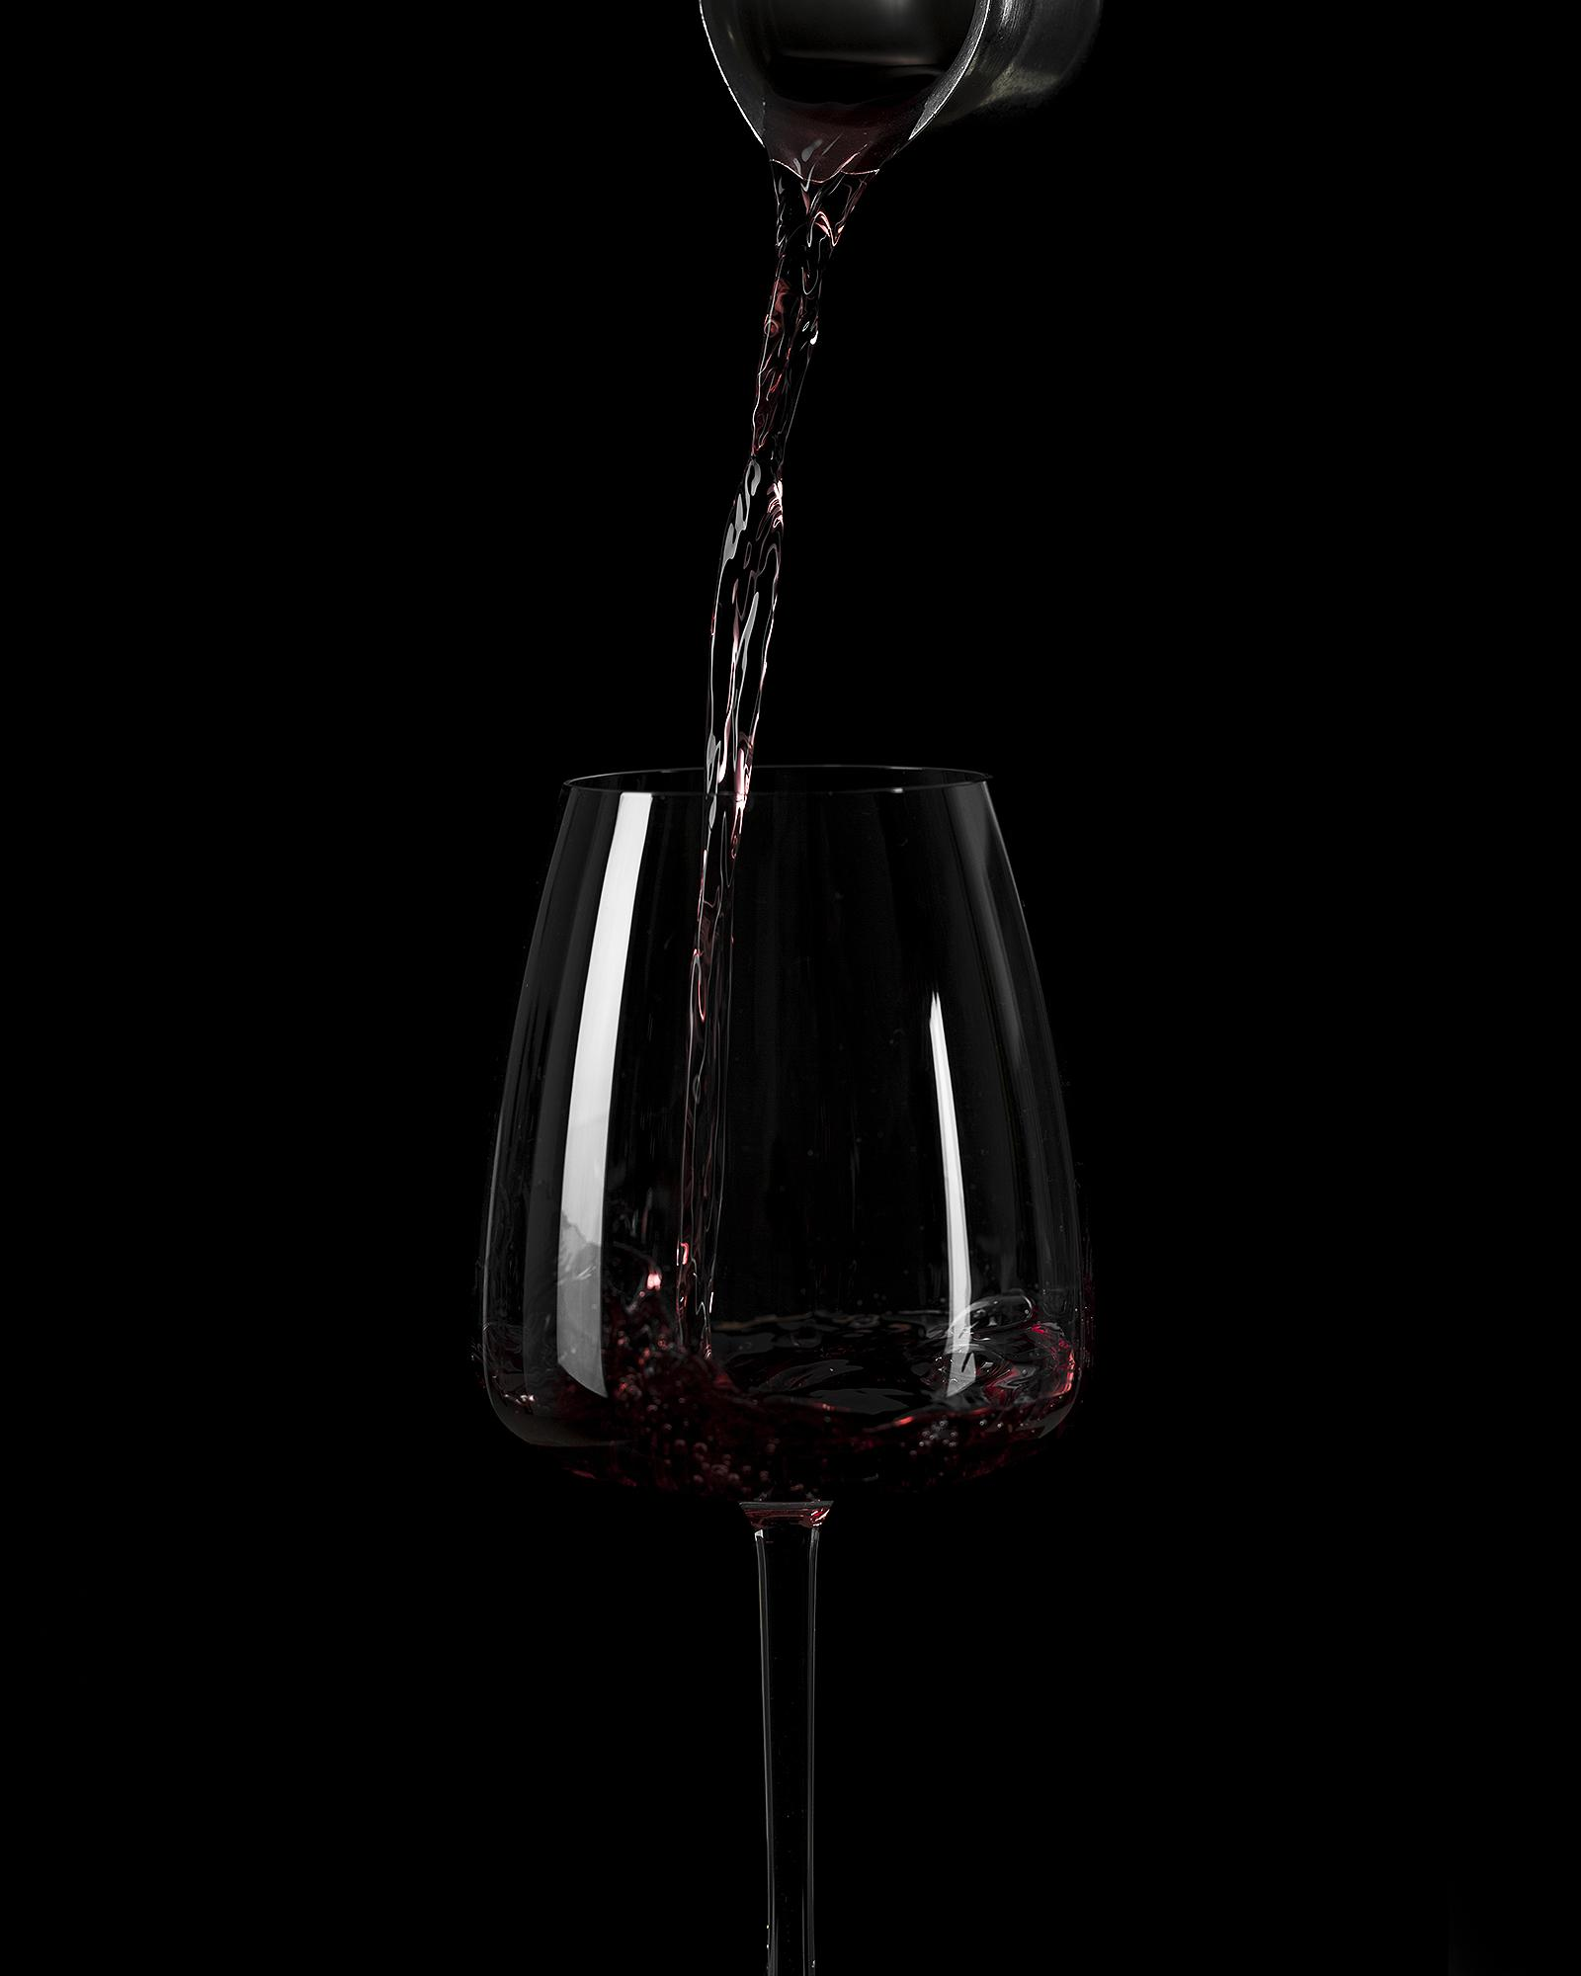

OUR PHILOSOPHY
Wine-alytics is committed to using data to find high quality wines and consulting on how to build exceptional wine portfolios
Mission
To share our passion for wine and make wine accessible to all
Vision
Culture
Passion
Integrity
Values
Notes:
Liz

Slide 8




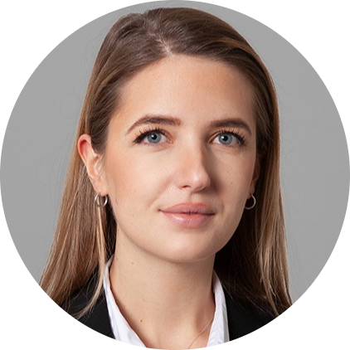

OUR TEAM
Liz Calvo
Michelle Halvorsen
Syed Hossain
Melanie Nyuydzefe
Greg Sobchuk
VP of Wine Education
VP of Data Science
VP of Data Analytics
VP of Wine Science
VP of Marketing & Operations
Notes:
Liz

Slide 9
OUR OFFERINGS
DISTRIBUTORS
WINERIES
We help distributors build wine inventories by providing and consulting them to increase profits through a powerful price classification tool to identify wines that are under- or overvalued
We help wineries understand what their wine quality is and consult them on producing high quality wine using tested physical chemistry components

Slide 10
—Robert Louis Stevenson
Scottish Novelist
“Wine is bottled poetry”
Notes:
Liz

Slide 11
02.
OUR CLIENTS & THE PROBLEM

Slide 12
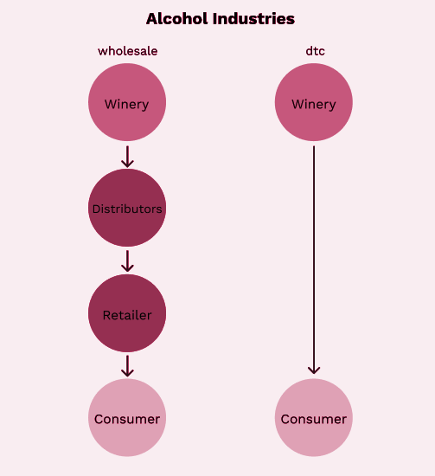
LOCATION: USA
Tier 1
We primarily focus on US wine industry
Tier 2
Tier 3
Notes:
Melanie
System established after the passage of the 21st Amendment ending prohibition in 1933. The regulation of alcohol sale and consumption was left to the states. Direct to consumer is becoming more more popular.
While direct-to-consumer (DtC) sales from wineries have risen dramatically since a 2005 Supreme Court decision opened most states to direct shipping

Slide 13
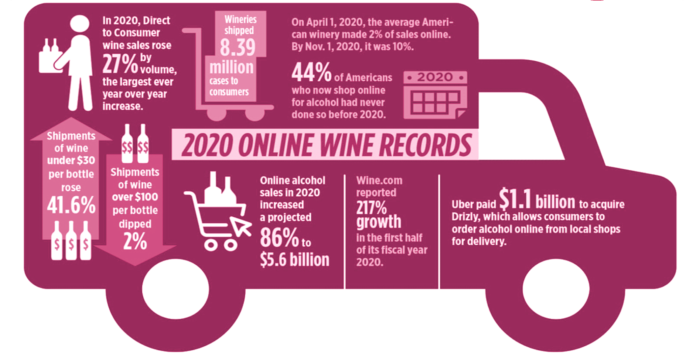
44%
Americans now shop online for alcohol for the first time before 2020
Notes:
Melanie
Highly competitive landscape
Wine is a competitive industry that requires creative promos and pricing models. Distributors need to be flexible and innovative on their pricing policy to maintain their competitive edge.

Slide 14
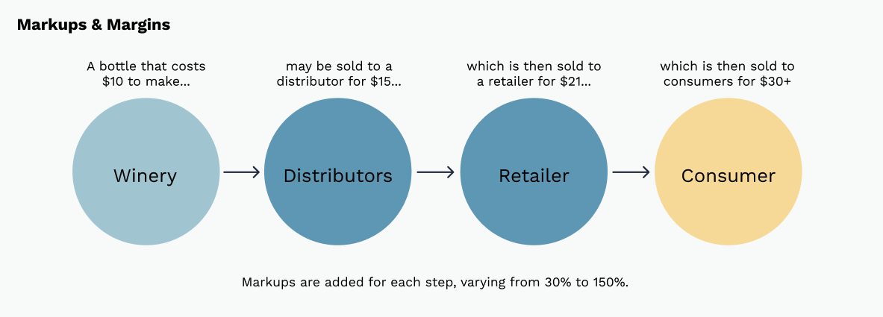
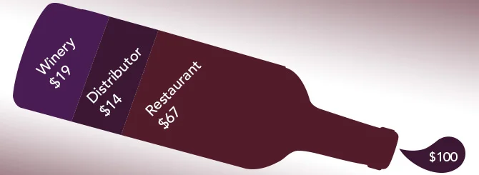
PROFIT MARGINS
50%
28-30%
Wineries
Distributors
30-50%
70%
Restaurants & Bars
Retailers
Napa Cabernet
Notes:
Melanie
Selling directly increase profit margins from 33% to 66%. Thats two fold increase.
How can winemarkers increase the quality of their wines so that they can increase and price and profit margin.

Slide 15
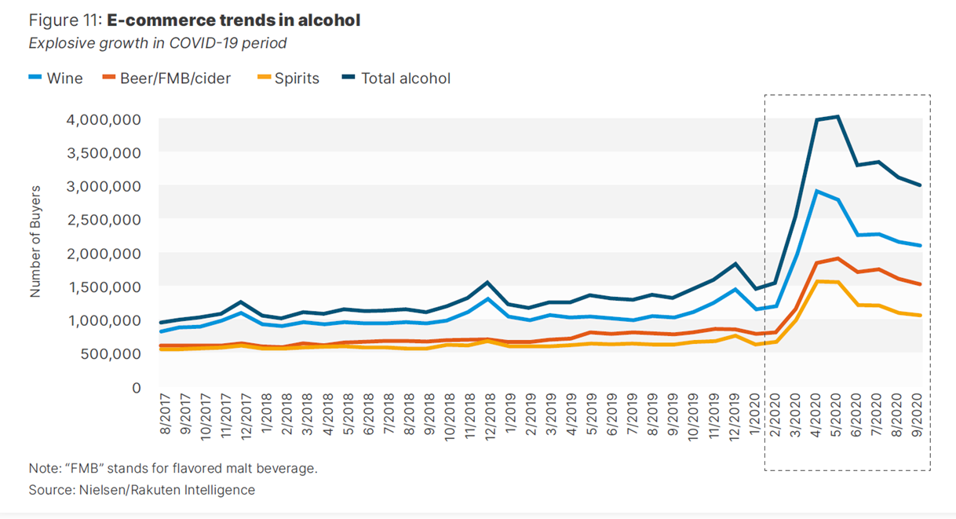
E-COMMERCE TRENDS IN ALCOHOL
Notes:
Melanie
Saw a higher shift in online wine sales than any other alcohol category
Wine marker can build there ecommerce business to capture higher 100% of the profit.

Slide 16
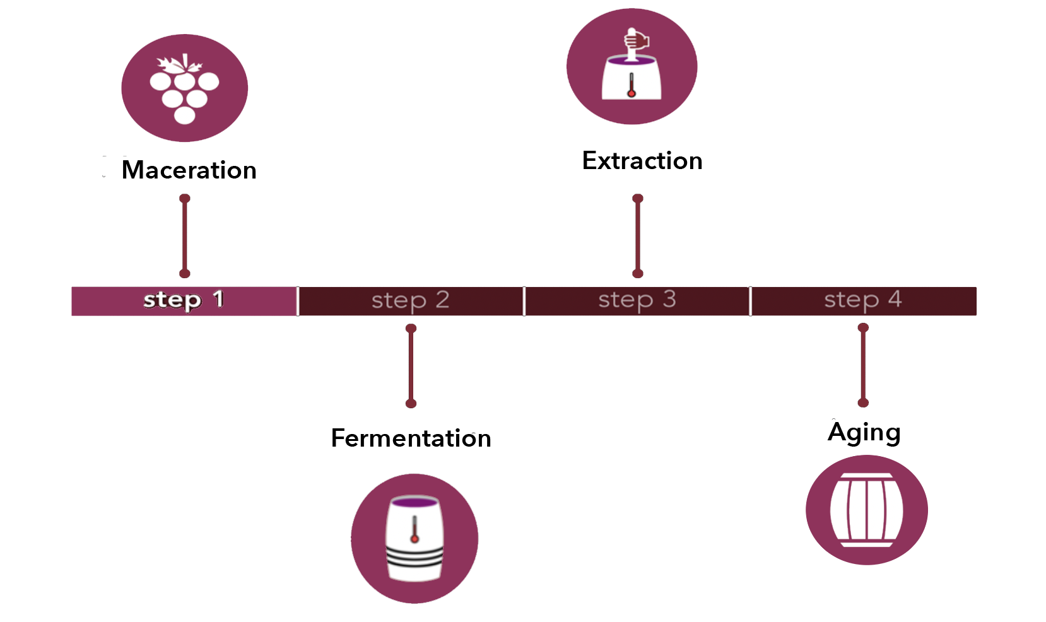
FACTORS AFFECTING WINE QUALITY
Notes:
Besides the obvious element such are the grape, soil, and climate are the four factors that affect wine quality.
●
1.Maceration
The maceration process is one of the most important factors affecting red wine quality because it has the greatest impact on the wine’s color and tannin level. Winemakers macerate grapes using one of two methods (though many variations of these techniques are also used):
•Traditional Maceration: During this process, winemakers lightly crush their grapes to release most of the juice and then let the pulpy mix (called the must) soak in the juice for a period of time. As the grape skins, seeds, and stems soak, they release tannins, flavor compounds, and pigment. Many winemakers heat the must in order to release more of these compounds into the wine and kickstart the fermentation process. This technique is usually only used for red wines, although some white varieties go through maceration in order to produce what are known as “orange” wines.
•Cold Soaking: This technique involves soaking freshly crushed grapes in a mix of water and sulfur dioxide. During cold maceration, winemakers keep the must at a low temperature in order to prevent the yeast in the wine from fermenting and producing alcohol. The longer the must soaks, the darker the wine will be. However, despite the dark coloration of the wine, this process actually extracts less tannin compared to traditional maceration. It’s similar to cold-brewing iced tea rather than making hot tea—iced tea tends to taste less bitter than hot tea because the cold water releases less of the bitter tannin in the tea leaves.
•
•If you primarily purchase white wines, then maceration isn’t typically a major factor affecting wine quality because white wines rarely go through this process.
2. Fermentation
Fermentation is the process by which grape “must” (a fancy winemaking term for unfermented grapes or juice) transforms into wine. ... Fermentation drives complex chemical reactions that affect the flavor, aroma, and even color of the finished wine
Fermentation is one of the primary factors affecting wine quality and flavor characteristics, in particular, the aroma of white wines. White wines are heavily influenced by certain fermentation techniques because their aromas are more delicate than those of bolder red wines.
3. Extracton
Extraction techniques can affect quality and intensity in both red and white wines. After the grapes are crushed and the juice begins fermenting, winemakers stir the juice to extract even more flavor compounds. To accomplish this, they usually use one of two basic stirring techniques:
•Pump-Over: In a pump-over system, a pump circulates juice from the base of the fermentation tank to the top, exposing the wine to as much oxygen as possible in the process. This exposure to oxygen releases tannins and other flavor compounds in the wine. Wines that are exposed to a great deal of oxygen and wines that were stirred fairly aggressively tend to be more intense in flavor than wines that were stirred more gently or exposed to less oxygen. In this sense, you can compare the pump-over process to swirling your wine glass during a tasting—the more the wine is swirled, the more prominent the flavor compounds and aromatics are.
•Punch-Down: Not all wines benefit from a pump-over system. As with maceration and fermentation, the extraction process can overpower subtle flavors in delicate wines. A punch-down system tends to be more gentle than a pump-over system and is commonly used to develop the flavors of light-bodied wines. Winemakers using this technique carefully press down on the cap of berries and skins at the top of the fermentation tank. They generally do this by hand to ensure that the liquid isn’t agitated too aggressively. The goal is to minimize contact with oxygen, allowing the flavor compounds to develop naturally with minimal intervention. The result is often a wine that is less intense than that made from a pump-over system, however, that doesn’t mean that these wines lack complexity. Some winemakers choose a punch-down system because their grapes are fully ripe and the resulting wine is already naturally complex.
4.Aging
Barrel- and bottle-aging techniques are significant factors affecting wine quality and their addition to the winemaking process can completely transform the flavor of the resulting wine.
Oak Aging: Most collectors already know that oak can add a woody flavor to wine, and, particularly in the case of American oak, a vanilla flavor.
The amount of time that a wine spends in barrels also has an impact on its aging potential. As the alcohol and water in the wine seep into the porous surface of the wood, the flavor compounds inside of the wine become more concentrated over time.
Unlined concrete and clay tanks have a softening effect on wine by reducing acidity.

Slide 17
03.
OUR PRODUCT
& PROJECT SUMMARY
Notes:
Syed

Slide 18
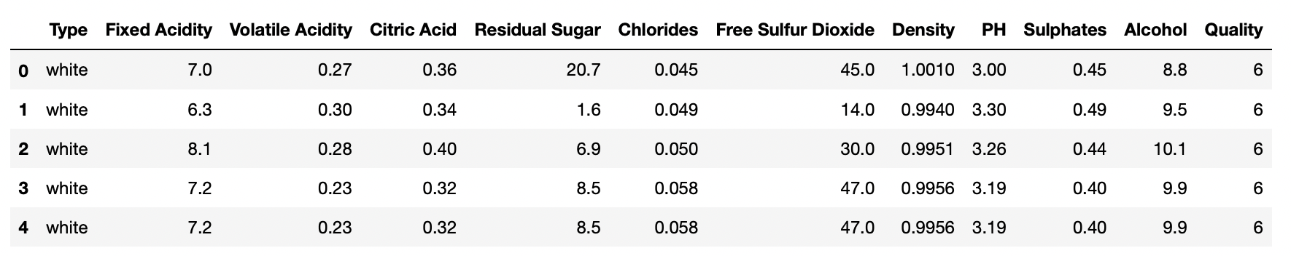
Data about 6.5k white and red wines . . . and continuing to expand!
12 different attributes analyzed
OUR WINE DATABASE
Attributes include:
Fixed Acidity
Volatile Acidity
Citric Acid
Residual Sugar
Chlorides
Sulphates
Free Sulfur Dioxide
Total Sulfur Dioxide
Density
pH
Alcohol
Quality
Notes:
Michelle
-we have 130K+ data to predict our analysis
- there 16 different variable in the dataframe
- we found some outlier and we removed the outliers to see the effect they will cause in the metrics of the models.
- we found slight less than 7% missing value in the price column dataset and we removed them.
- we are dropping insignificant variables to improve our prediction
-

Slide 19
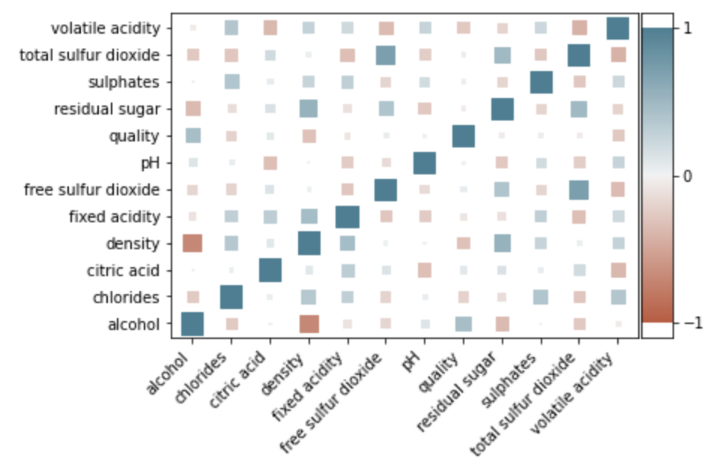
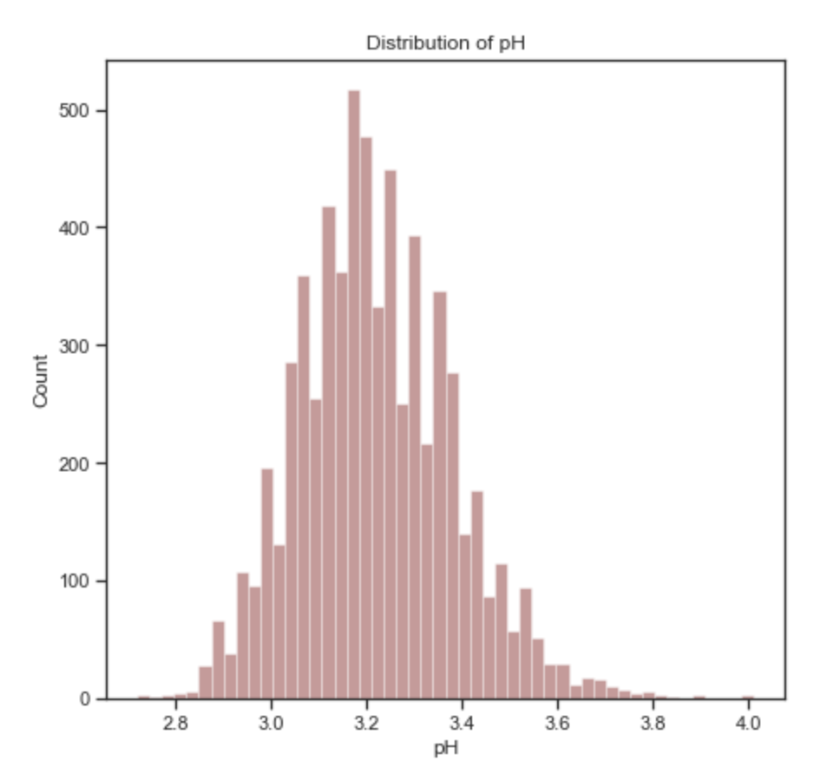
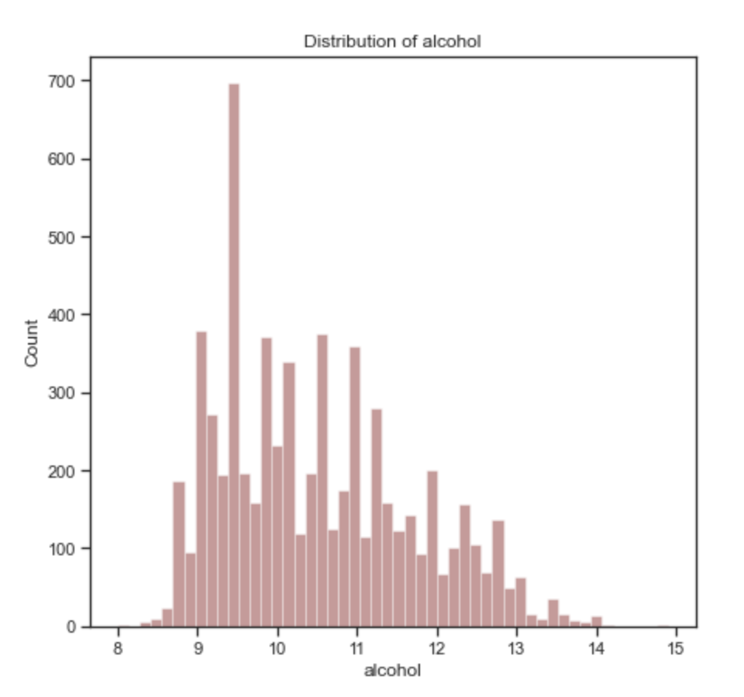
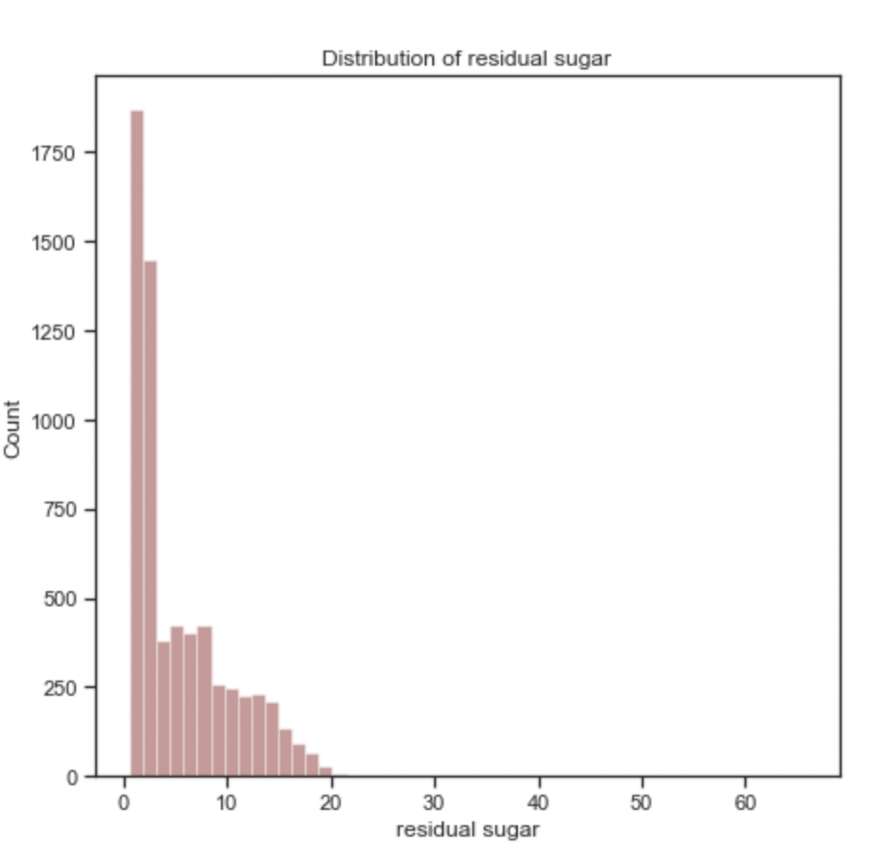
QUICK OVERVIEW
Please note, this code is using Hungarian notation
Notes:
Michelle
-we visualized distribution of price, points, and varieties.
-we are cross checking price and point relationship
- we are also selecting top seven countries from the dataset
- we saw price skewed to right which mean that data is not normally distributed.
- we used normalize technique to fix the skewed price data
- we range wine by price that my group mate Michael will discuss later

Slide 20
BASELINE
AUC
ANALYSIS
Model | Accuracy (AUC)
Gradient Boosting (Train) | 0.754316396
Gradient Boosting (Valid) | 0.660857588
Logistic Regression (Train) | 0.745076422
Logistic Regression (Valid) | 0.73440432
Random Forest (Train) | 1.00
Random Forest (Valid) | 0.726584022
Naive Bayes (Train) | 0.697343023
Naive Bayes (Valid) | 0.698421967
Decision Tree (Train) | 0.626282394
Decision Tree (Valid) | 0.589027628
Model
Accuracy
(overfitting)
Notes:
Syed

Slide 21
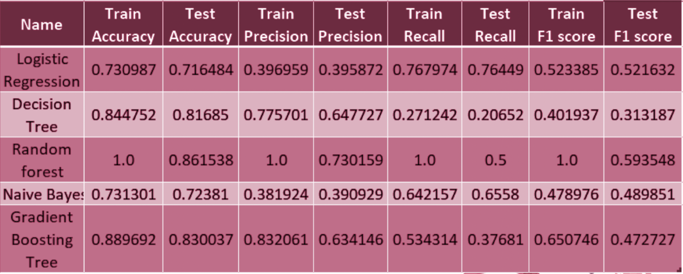
4 Main Performance Metrics
Accuracy
Precision
Recall
F1-Score
MODEL METRICS
Notes:
Syed

Slide 22
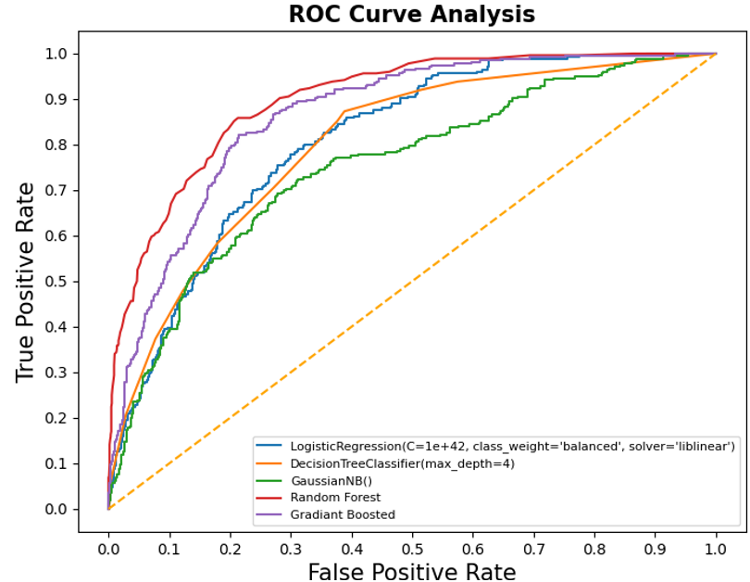
ADDRESSING FALSE POSITIVES
Best performing model overall: Gradient Boosting
Gradient Boosting
(overfitting)
Notes:
Syed
Is the message clearer if we set it up this way?

Slide 23
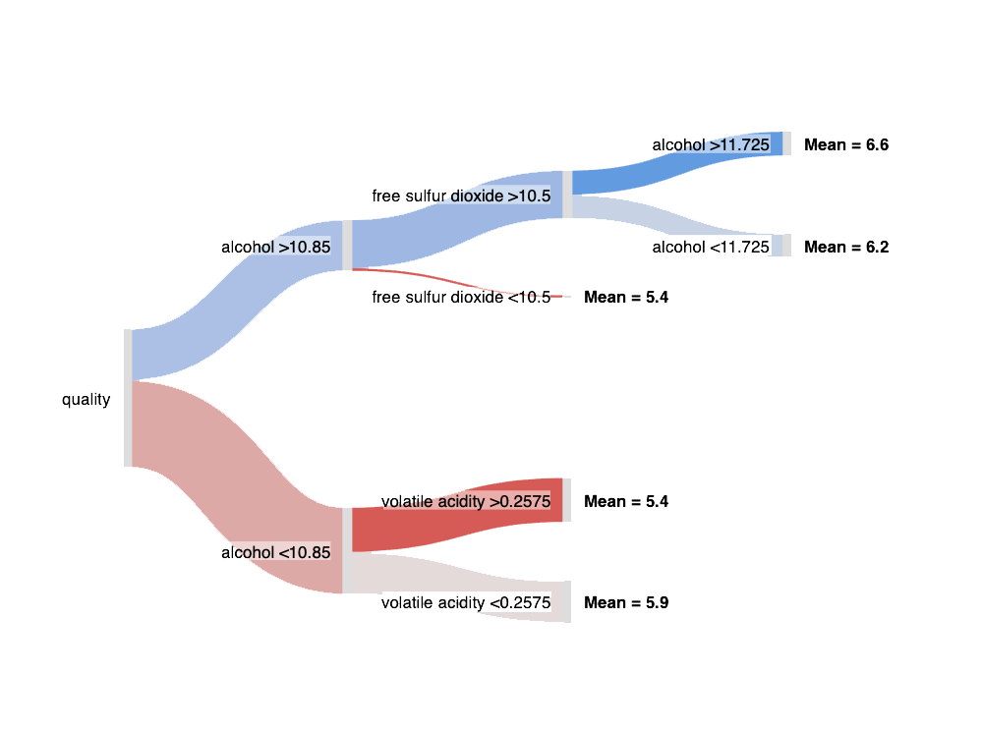
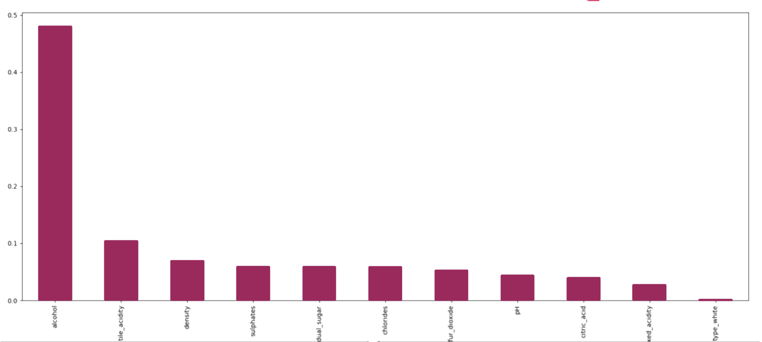
WHICH FEATURES MATTER?
Consensus among the models
alcohol
Importance
volatile acidity
total sulfur dioxide
sulphates
residual sugar
density
chlorides
citric acid
fixed acidity
pH
type white
Please note, this code is using Hungarian notation
Notes:
Syed
Should we use this? Sankey diagram revealed the information more efficiently

Slide 24
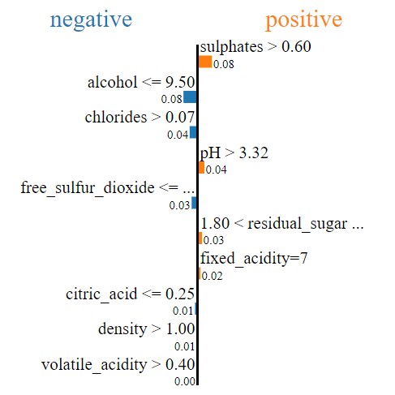
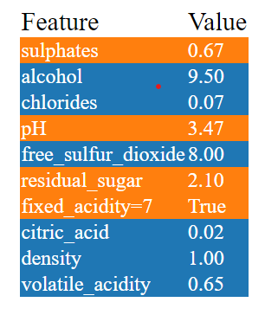
LIME Representation Gradient Boosted Tree
Negative
Positive
Please note, this code is using Hungarian notation
Notes:
Syed

Slide 25
HOW WE CAN HELP YOU
Utilize our machine learning algorithms to address the chemical components in your wine, and tailor the values to achieve the highest possible quality score
Notes:
Michelle

Slide 26
QUALITY
QUALITY BOOSTING ALGORITHM
Components
YOUR WINE
Notes:
Michelle

Slide 27
HOW DOES IT WORK?
Notes:
Michelle

Slide 28
STEP 1:
IDENTIFYING THE QUALITY COMPONENTS OF SIGNIFICANCE FOR YOUR WINE
COMPONENT 1
COMPONENT 2
$16-25.9
YOUR WINE
$4-15.9
COMPONENT 3
Notes:
Michelle

Slide 29
STEP 2:
MACHINE LEARNING GRADIENT BOOSTING ALGORITHM TO DETERMINE OPTIMAL VALUE OF EACH COMPONENT
+COMPONENT 2
- COMPONENT 1
$16-25.9
YOUR WINE
QUALITY
- COMPONENT 3
Notes:
Michelle

Slide 30
04.
DELIVERABLES & PARTNERSHIP BENEFITS

Slide 31
DELIVERABLE TIMELINE
Team Introduction and Road-Mapping
Onsite Trainings and continued harvest analysis
OVER THE NEXT 2 WEEKS
ONGOING
TODAY
OVER THE NEXT 3 MONTHS
Harvest Analysis (Grape analysis)
Data Optimization and refinement
Notes:
Greg

Slide 32
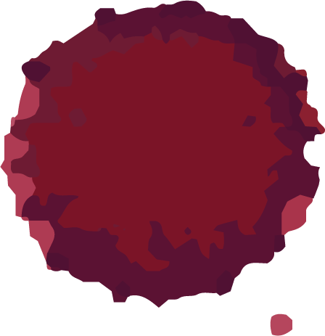
PARTNERSHIP TIERS
01
04
Ruby
Ideal for large-scale wineries looking for a long-term partnership to optimize growth
Gold
Built for wineries looking for data to drive sales
Silver
Customized for smaller-scale wineries looking for immediate consulting
Notes:
Greg

Slide 33
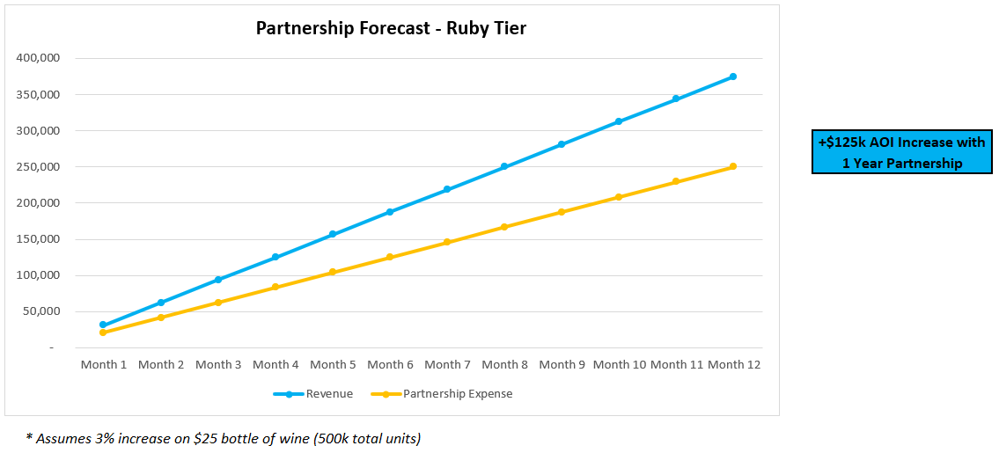
RUBY PARTNERSHIP
On-site consulting for one-month with our team of experts
Life-time access to our proprietary data, with monthly updates throughout partnership term
Access to Master Wine Data Analytics Scientist throughout partnership term (20 hours per week)
Partnership Cost Structure ($250k for one-year term)
- Additional benefits to be billed incrementally as delivered
Notes:
Greg

Slide 34
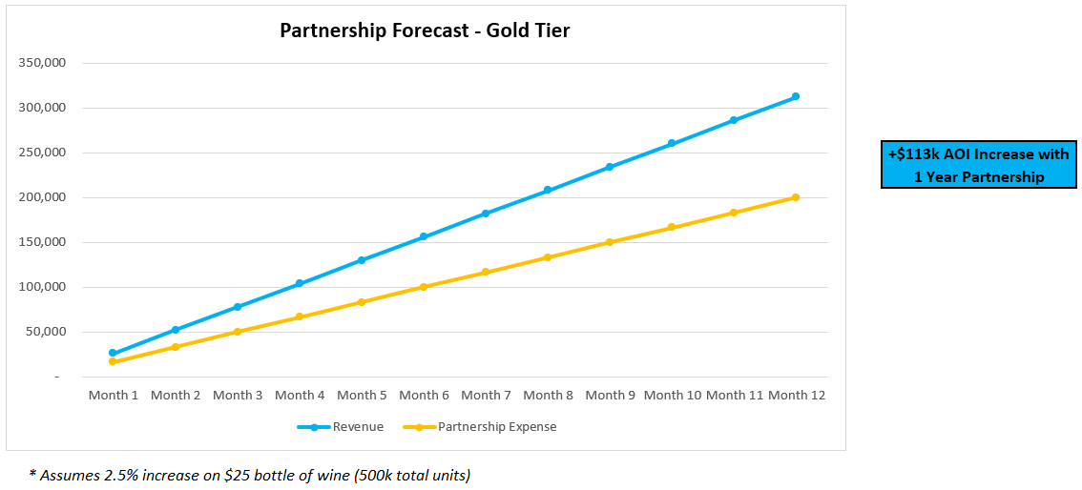
GOLD PARTNERSHIP
On-site consulting for one-month with our team of experts
Life-time access to our proprietary data, with quarterly updates throughout partnership term
Access to Master Wine Data Analytics Scientist throughout partnership term (20 hours per week)
Partnership Cost Structure ($200k for one-year term)
- Additional benefits to be billed incrementally as delivered
Notes:
Greg

Slide 35

SILVER PARTNERSHIP
On-site consulting for one-month with our team of experts
Life-time access to our proprietary data
Access to Junior Wine Data Analytics Scientist throughout partnership term (2 hours per week)
Partnership Cost Structure ($100k for one-year term)
- Additional benefits to be billed incrementally as delivered
Notes:
Greg

Slide 36

THANK YOU!
CHEERS!
Notes:
Idea for Final:
Bring in a bottle of wine. How much do you think that bottle is worth?

Slide 37


CONTACT US
Do you have any questions?
WhenDataMeetsWine@winealytics.com
212-800-8000
winealytics.com

